Slide 2
www.ConnectWithJared.com

Slide 3
How Leads Have Changed
69%
<44%
Referrals
5 YEARS AGO
2016
of Buyers & Sellers Start Online*
of Buyers Found Agent Online**
of Sellers Found Agent Online**
*NAR Research
**Real Trends Report

Slide 4
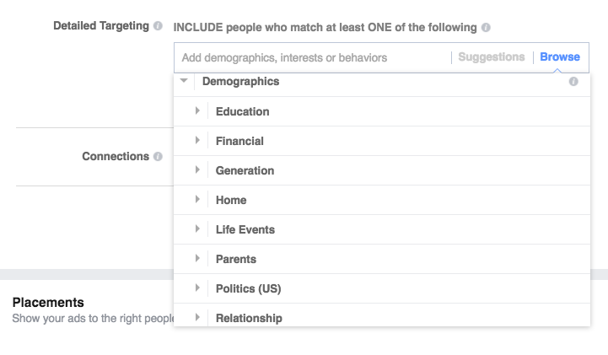
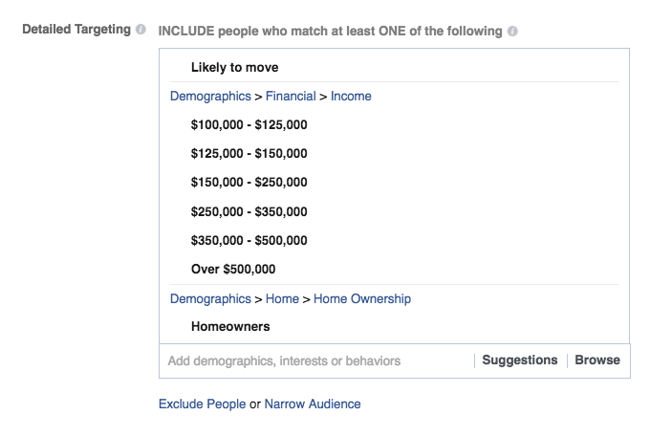
Facebook Targeting
Specific Address
Targeting
Search Demographics
Specific Targeting
Details

Slide 5
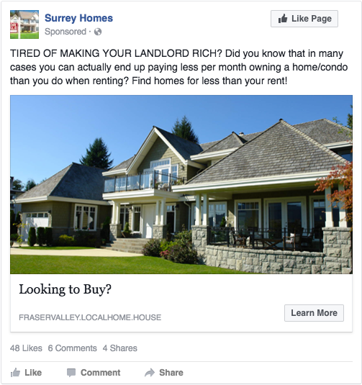
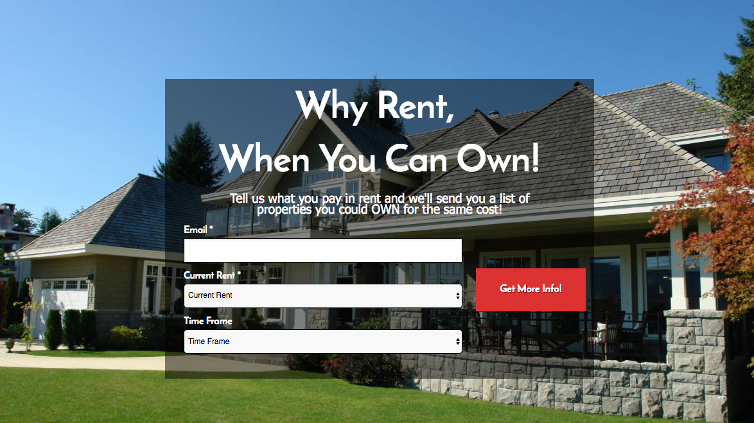
BUYER LEADS
LANDING PAGE
AD

Slide 6
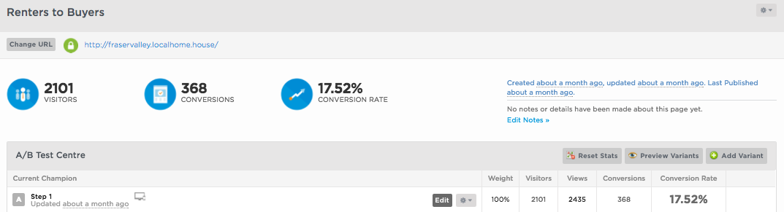
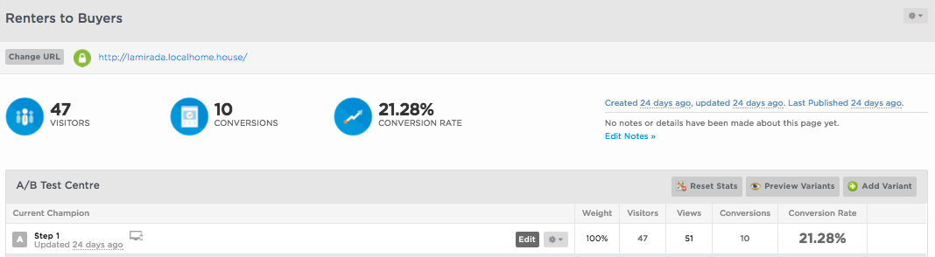
PERFORMANCE
Zip Codes= 3
Daily Spend= $30
Duration= 1 Month
Zip Codes= 1
Daily Spend= $5
Duration= 14 Days

Slide 7
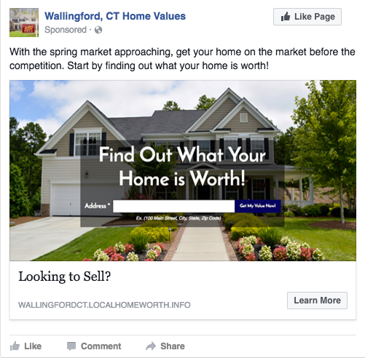
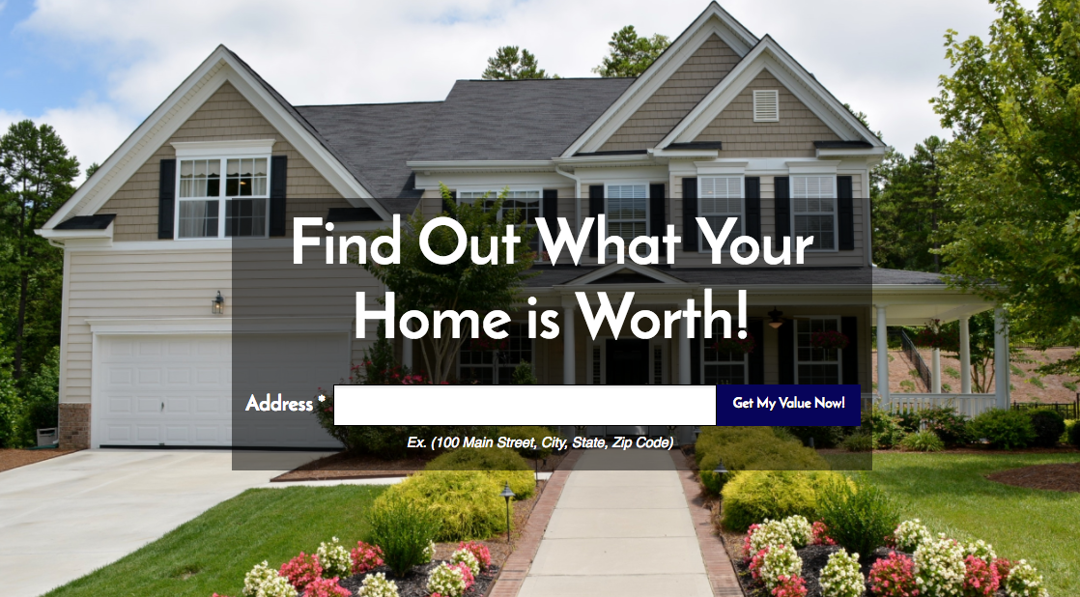
SELLER LEADS
LANDING PAGE
AD

Slide 8
PERFORMANCE
Zip Codes= 1
Daily Spend= $5
Duration= 1 Month
Zip Codes= 1
Daily Spend= $5
Duration= 2 Months

Slide 9
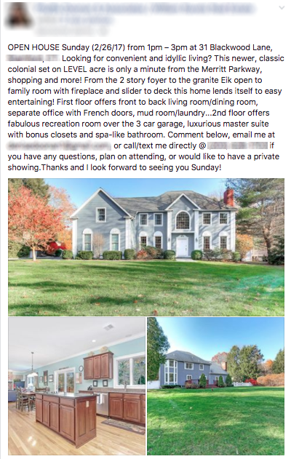
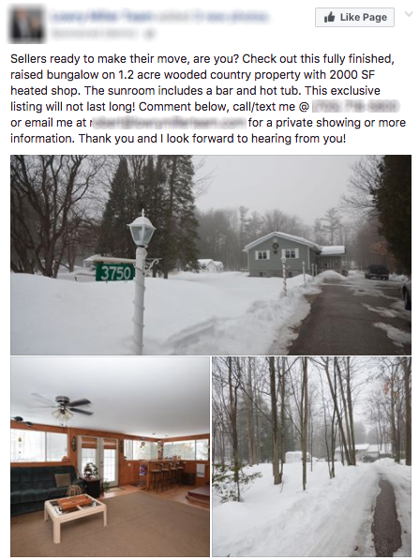
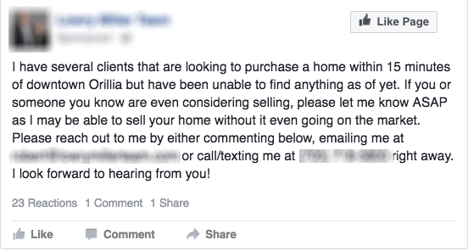
LISTINGS POST
Open House
Listing
Generic Seller

Slide 10
Details to Leave Out
There are some details we leave out, ON PURPOSE! The reason is to promote engagement. The most common questions asked will help determine who is REALLY interested.
Price
Bedrooms
Square Footage
Location*
*Only when promoting a listing. You want the leads to know where to go for the Open House

Slide 11
Daily Budget Affects Performance
The More You Spend the More People See Your Ad
$5
DAILY
$10
DAILY
$30
DAILY
Engagement
Estimated Daily
Reach
370-990
680-1,800
1,600-4,100
Traffic
Estimated Daily
Reach
330-860
510-1,300
1,300-3,500
Based on a population of 49,000 Facebook users

Slide 12
Do You Know What KPI’s Are?
Key Performance Indicators
L
R
Lead Creation
Role Playing
A
Appointment Setting

Slide 14
WEBINAR PROMO
THE FIRST 50 PEOPLE TO SIGN UP
Marketing Pro
Listings Program
Marketing Pro Upgrade
Starts at
$74
For 1st MONTH
Starts at
$74
For 1st MONTH
$89
MONTHLY
Setup Fee
$0
WAIVED
Stealth Business Page
Your Business Page
Converts Partial Leads to Full
Generic Ad
Specific Ads
Provides Emails, Cell/Phone Numbers, etc.
Generic Business Page
Facebook Engagements
Comes with Lead Information
Buyer or Seller Leads
Your Submit the Post for Creation

Slide 15
3 Levels of Context
They Have to Know You
Branding
They Have to Quickly
Feel Like They Know You
They Have to Get to Know You
Video
Follow Ups

Slide 16
What’s Needed to Close a Lead
Consistency
Speed
Smarts
Stand Out*
Leverage
Closed
Lead
Urgency
*www.Emojipedia.com
Humanity
Say it Right
Closer not Sales
Skill

